Slide 1

Build a BinderHub The #TuringWay team Sheffield workshop, 18th March 2019

Slide 2
Housekeeping

Slide 3
Agenda
9.30 - 10.00: Registration, coffee and introductions
10.00 - 10.30: Introduction to the workshop and The Turing Way
10.30 - 11.00: Introduction to Binder and why you should build a BinderHub
11.00 - 12.30: Zero to BinderHub
12.30 - 1.30: Lunch
1.30 - 2.00: Pico-WOW: Contributing to Binder
2.00 - 3:30: Collaborative working
2.45 - 3.00: (Coffee halfway through the hack)
3.30 - 4.00: Looking forwards: Progress review, lessons learned and future strategies
4.00 - 5.00: Optional hangout with instructors

Slide 4
Notetaking
bit.ly/BinderHubShef

Slide 5


Founding the Institute
“We will found The Alan Turing Institute to ensure Britain leads the way again in the use of big data and algorithm research”
George Osborne, Chancellor of the Exchequer
Budget Speech, March 2014
Network of industry, charity, government partners
Network of university members
Strategic government investment
18/03/2019

Slide 6























The Institute’s partners and collaborators

Slide 7
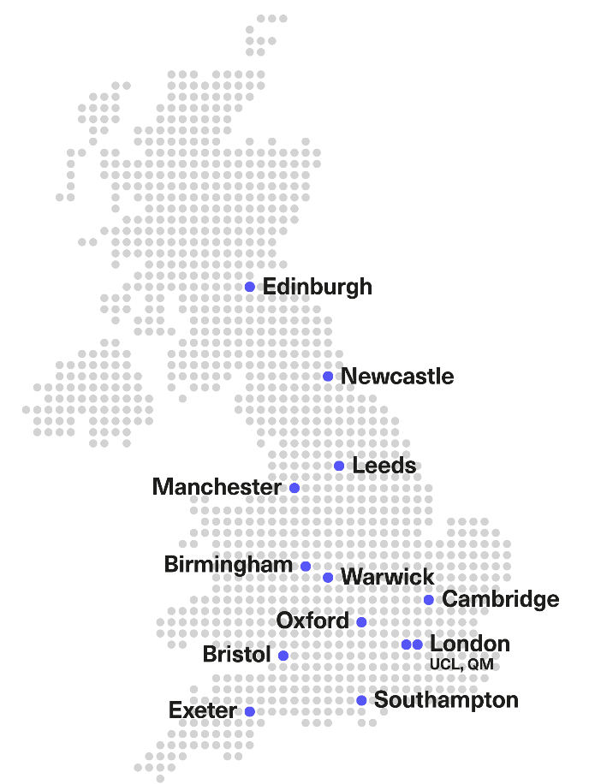













Our university network

Slide 8
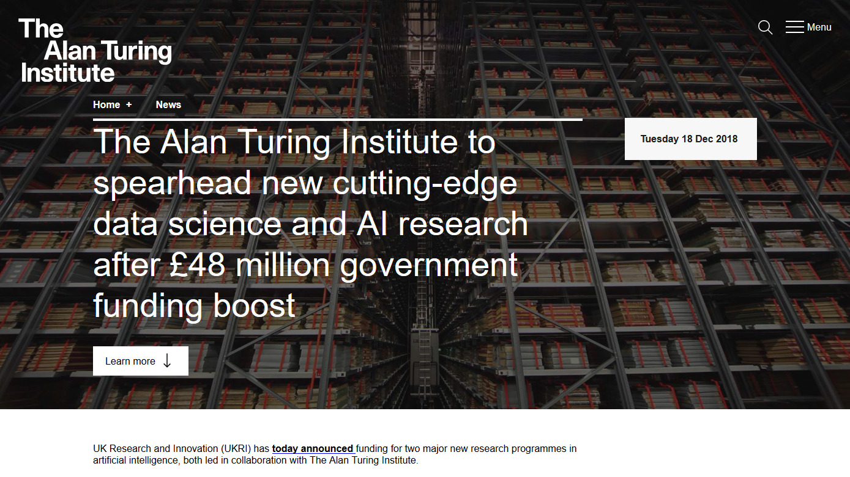
https://www.turing.ac.uk/news/alan-turing-institute-spearhead-new-cutting-edge-data-science-and-artificial-intelligence
Notes:
The Alan Turing Institute, via EPSRC and in collaboration with a number of other research councils, has been awarded a £40 million research programme through UKRI’s Strategic Priorities Fund into technologies of AI that will provide an all-pervading underpinning of future development in many sectors.
This research will support a range of objectives covering four high-priority areas, with the aim to transform:
engineering and urban planning, through the development of ‘digital twins’, digital replicas of physical systems.
health, through applying machine learning to assist in the detection and diagnosis of illness, and the planning and personalisation of medical treatment.
the physical and life sciences, through applying AI to the vast amounts of data generated by scientific research.
criminal justice, through developing the technical tools as well as the ethical foundations to prevent crime, identify and rehabilitate offenders, and improve the operation of the criminal justice system.
This programme is being led by the Engineering and Physical Sciences Research Council (EPSRC) in collaboration with The Alan Turing Institute, Biotechnology and Biological Sciences Research Council (BBSRC), Medical Research Council (MRC), Natural Environment Research Council (NERC) and Science and Technology Facilities Council (STFC). It includes policy support from the Home Office and the Ministry of Justice.
Researchers at The Alan Turing Institute will work across some of these challenges with government departments, such as the Home Office and the Ministry of Justice. In addition, the outcomes of this programme will support the policy development of other government departments, such as the Department for Transport, the Department for Environment, Food & Rural Affairs and DHSC. This programme will ensure that the UK meets the AI needs of the Industrial Strategy and stays competitive internationally.

Slide 9
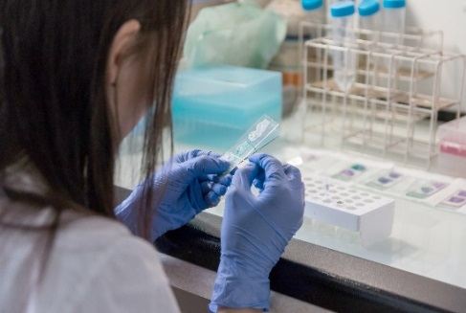




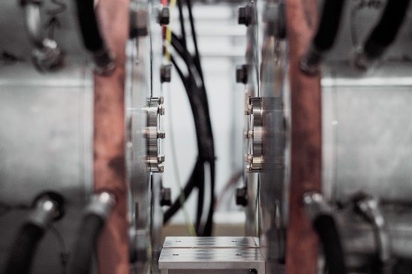
Digital twins: Cities
AI for science
Criminal justice system
Health
Digital twins: Complex
systems engineering
Tools, practices and systems for AI

Slide 10
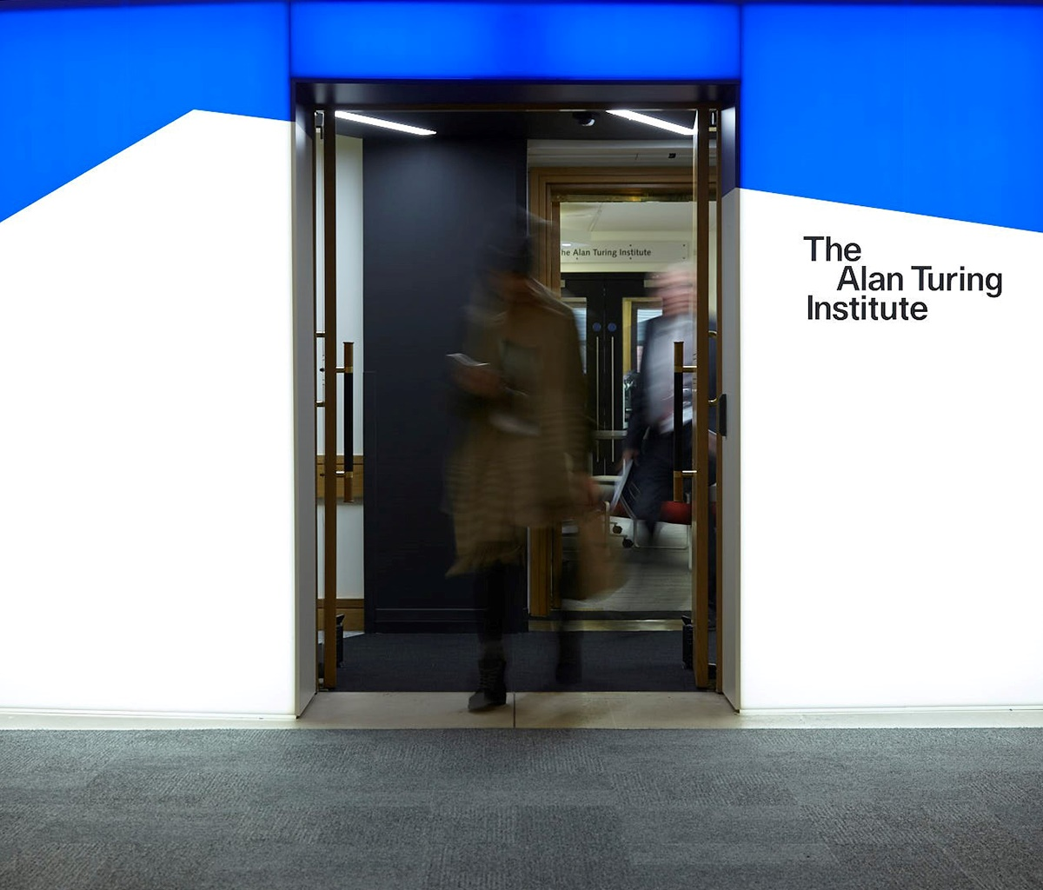
The Turing Way A lightly opinionated handbook for reproducible data science https://github.com/alan-turing-institute/the-turing-way

Slide 11
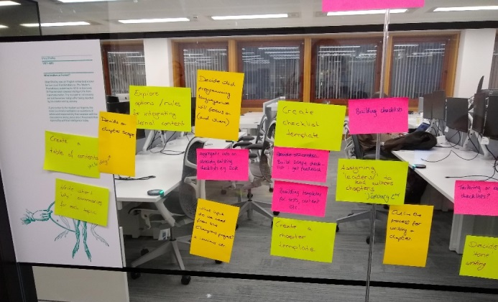
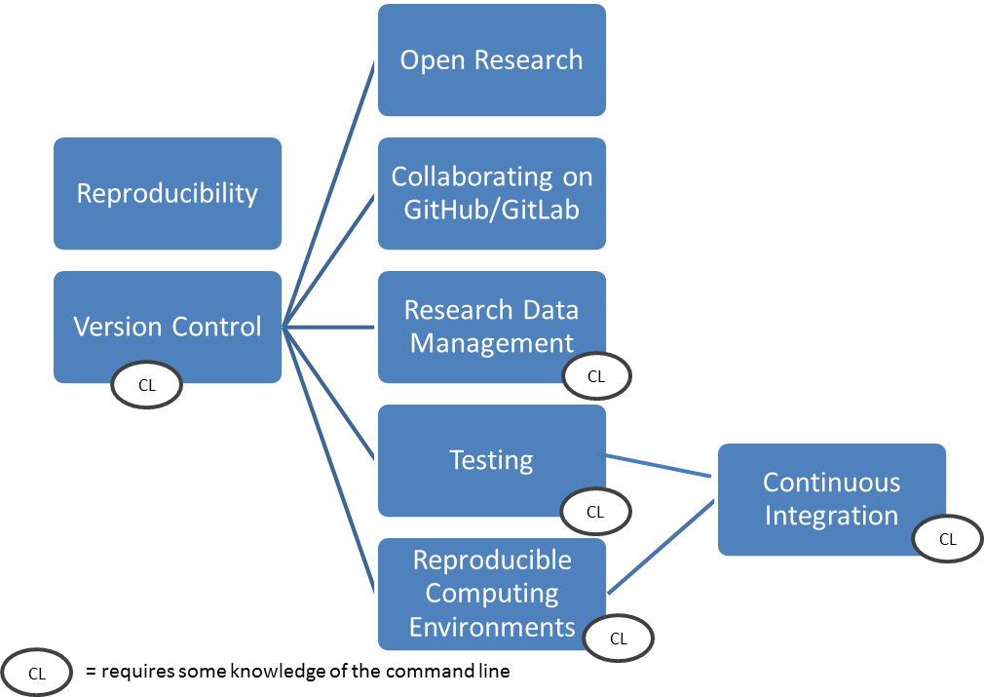
Including chapters on:
https://github.com/alan-turing-institute/the-turing-way/blob/master/book_skeleton.md
Notes:
+ many desirable chapters that we hope to add after the launch

Slide 12

Checklists for researcher, PI and admin team
Researcher
Version control
Capturing compute environment
Writing and running the code
PI
Results presented are those from the final run of the analysis
Check that another researcher can run the code
Admin
Version control
Data and code archive
Open access publication
https://github.com/alan-turing-institute/the-turing-way/blob/master/book_skeleton.md
This Photo by Unknown Author is licensed under CC BY-SA

Slide 13
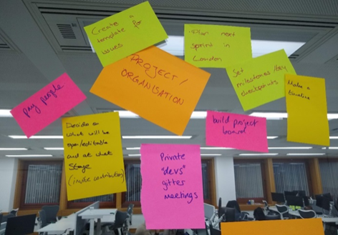
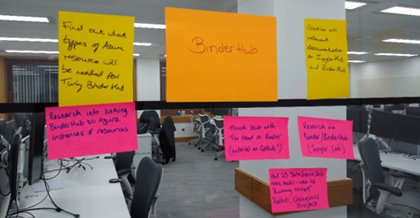
And more…
The Turing Way
Handbook
BinderHub
Community

Slide 14




Open Leadership Principles
Understanding You make the work accessible and clear
Sharing You make the work easy to adapt, reproduce, and spread
Participation & Inclusion You build shared ownership and agency to make the work inviting and sustainable for all.
Read more
https://mozilla.github.io/olm-whitepaper
@kirstie_j
https://doi.org/10.6084/m9.figshare.7564682
Notes:
You will learn about this in the picoWoW later

Slide 15
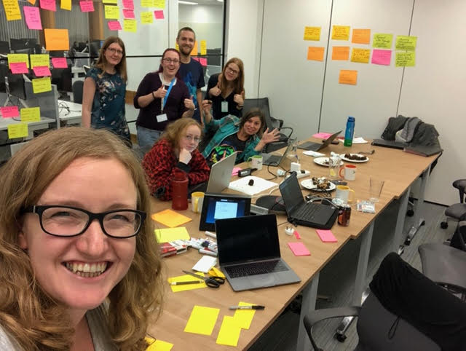
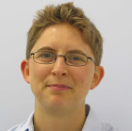
Built by a team….and you!
Becky Arnold
Louise Bowler
Sarah Gibson
Patricia Herterich
Rosie Higman
Anna Krystalli
Alex Morley
Martin O’Reilly
Kirstie Whitaker
…
Notes:
Thanks to our superstar helpers today.

Slide 16
How can you get involved?
Through attending one of our workshops and providing feedback on how we’re doing
Contribute a case study at https://goo.gl/forms/akFqZEIy2kxAjfZW2
Suggest additional content or even write (part of) a chapter – get involved on GitHub! https://github.com/alan-turing-institute/the-turing-way


Slide 17
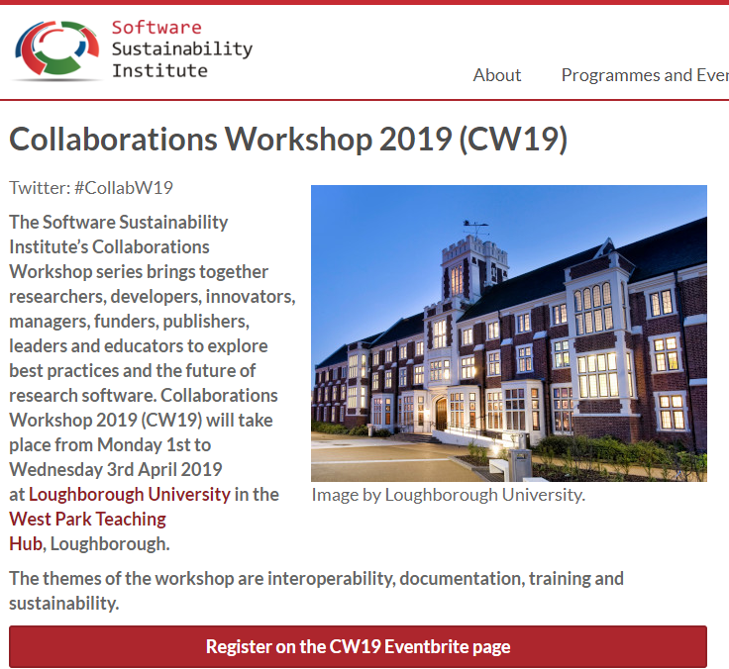
Join us for the launch!
SSI Collaborations Workshop 2019 in Loughbourough
Session 3
On Tuesday 2 April 2019, 15:30 - 16:10
Register at:
https://www.software.ac.uk/cw19

Slide 18

Why does reproducible research matter?

Slide 19
What does reproducible mean?
 |  | Data
 |  | Same | Different
Analysis | Same | Reproducible | Replicable
 | Different | Robust | Generalisable
https://dx.doi.org/10.6084/m9.figshare.7140050

Slide 20
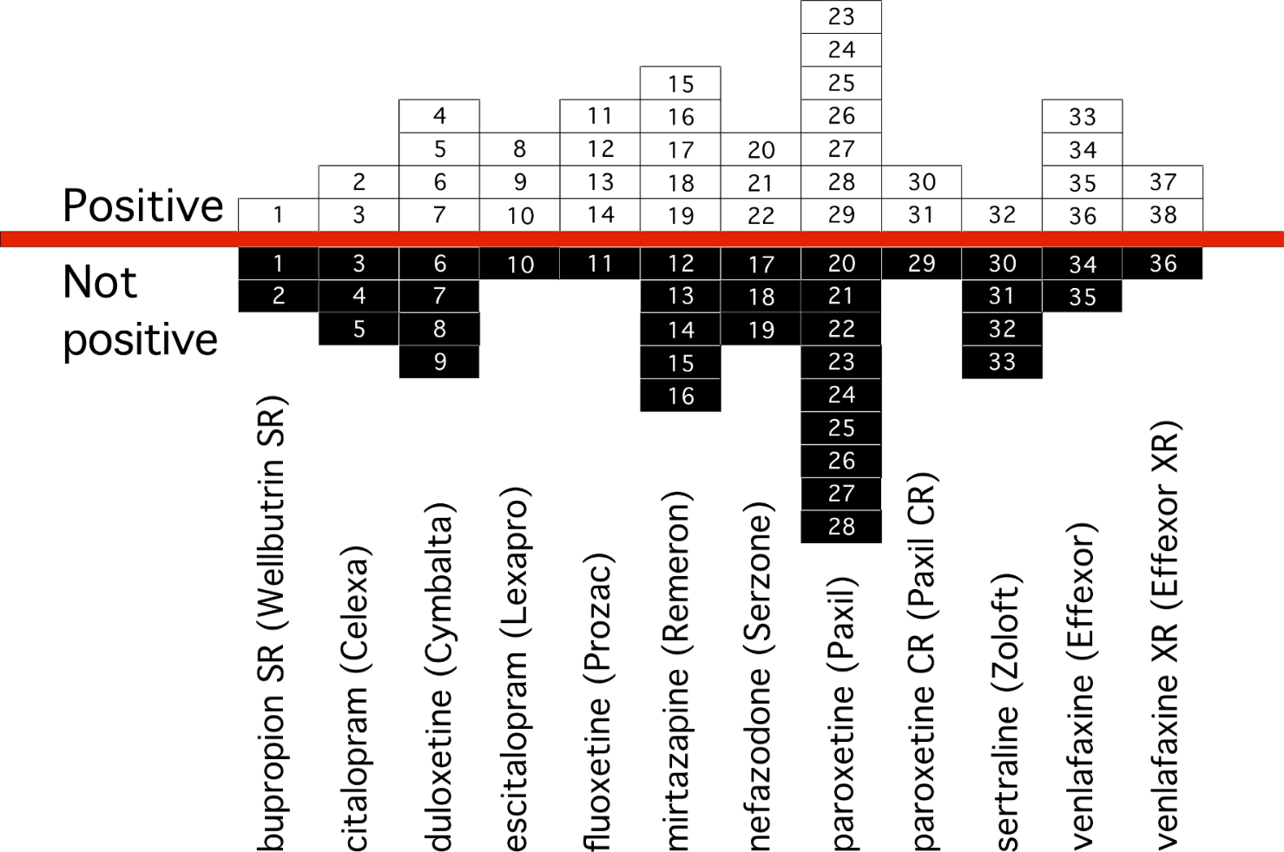
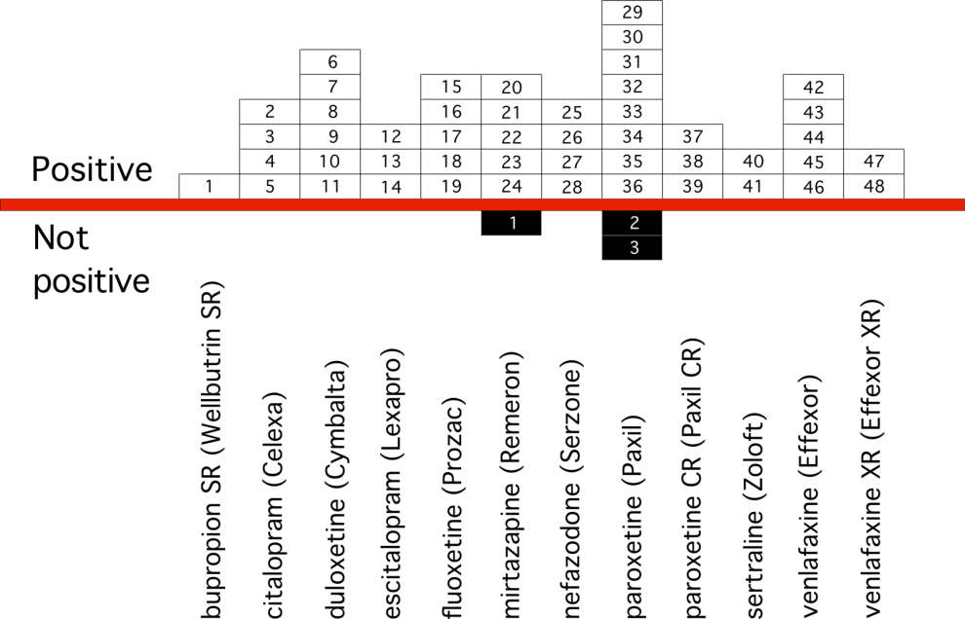
Why does this matter?
https://doi.org/10.6084/m9.figshare.3381379.v1
Notes:
Peer review After Results are Known: Are we “PARKing” the Cart Before the Horse?
The peer review will be prone to bias as long as it occurs after study results are known. This allows one to “torture the data until it confesses” to a statistically significant result. When studies refuse to “confess” and remain negative, authors and/or journals generally regard them as “not interesting” or “not publishable”.
Such reporting biases become apparent when we use an “inception cohort” of trials from FDA Drug Approval Packages (left) and compare those results to corresponding journal articles (right( —this approach will be demonstrated with psychotropic drugs. The FDA’s immunity to these biases lies largely in the fact that is it aware of each trial’s existence—and prespecified methods—before study inception.

Slide 21
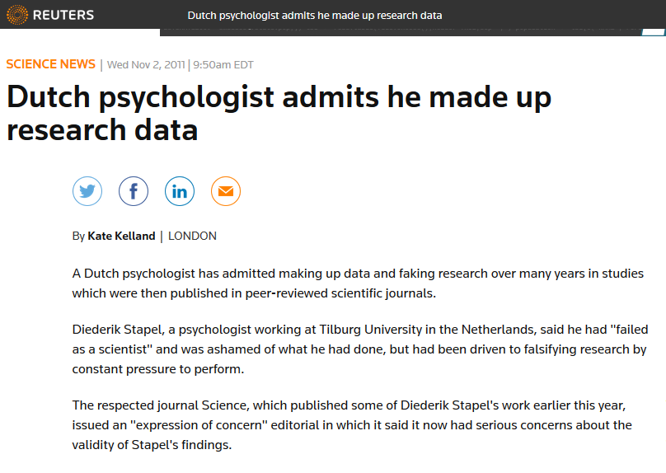
Why does this matter?
https://doi.org/10.6084/m9.figshare.3381379.v1

Slide 22
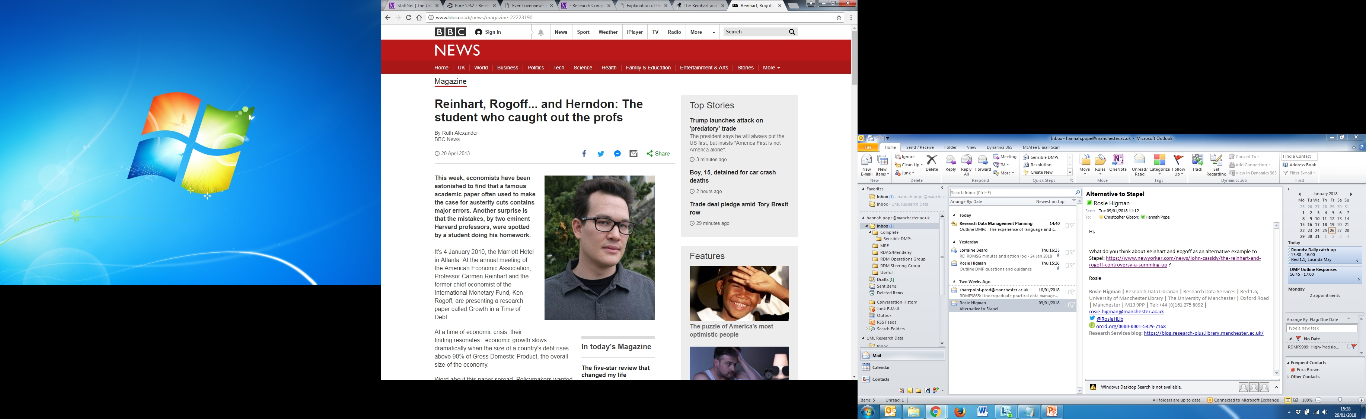
Why does this matter?
https://doi.org/10.6084/m9.figshare.3381379.v1
Notes:
Psychology, economy, machine learning -> this is an issue across disciplines!

Slide 23
Why don’t people do this already?
Is not considered for promotion
Takes time
Publication bias towards novel findings
Barriers to reproducible research
Requires additional skills
Plead the 5th
Held to higher standards than others
Support additional users
https://dx.doi.org/10.6084/m9.figshare.7140050

Slide 24
Why don’t people do this already?
Is not considered for promotion
Takes time
Publication bias towards novel findings
Barriers to reproducible research
Requires additional skills
Plead the 5th
Held to higher standards than others
Support additional users
https://dx.doi.org/10.6084/m9.figshare.7140050

Slide 25
How can the Turing Way help?
Make reproducibility, “too easy
not to do”
Share the responsibility
of reproducibility
https://github.com/alan-turing-institute/the-turing-way/blob/master/book_skeleton.md

Slide 26
Plan for today https://github.com/alan-turing-institute/the-turing-way

Slide 27
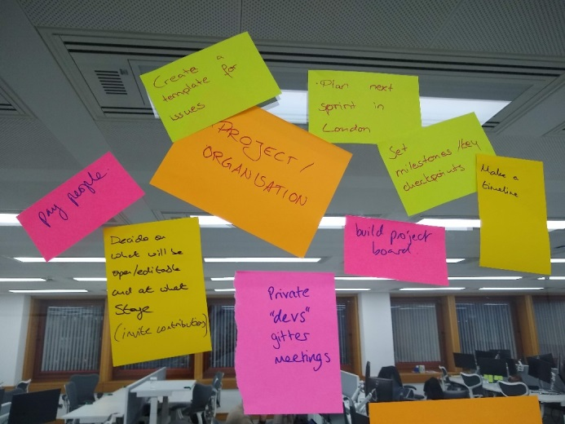
Goals
Learn what Binder is and how it can help
Build your own BinderHub!
Feed back on BinderHub documentation and features
Think about how a BinderHub for your institution/department could look like…
In a supportive and friendly environment!

Slide 28
Code of Conduct
“The Turing Way team are dedicated to providing a welcoming and supportive environment for all people…we do not tolerate behaviour that is disrespectful to our community members or that excludes, intimidates, or causes discomfort to others.”
https://github.com/alan-turing-institute/the-turing-way/blob/master/CODE_OF_CONDUCT.md

Slide 29
Code of Conduct
Be respectful of different viewpoints and experiences.
Use welcoming and inclusive language.
Do not harass people.
Respect the privacy and safety of others – stickers available if you don’t want your photo taken
Be considerate of others’ participation.
Don’t be a bystander.
https://github.com/alan-turing-institute/the-turing-way/blob/master/CODE_OF_CONDUCT.md
Notes:
For any concerns – contact Kirstie or Anna or email additional contact person noted on GitHub

Slide 30
Agenda
9.30 - 10.00: Registration, coffee and introductions
10.00 - 10.30: Introduction to the workshop and The Turing Way
10.30 - 11.00: Introduction to Binder and why you should build a BinderHub
11.00 - 12.30: Zero to BinderHub
12.30 - 1.30: Lunch
1.30 - 2.00: Pico-WOW: Contributing to Binder
2.00 - 3:30: Collaborative working
2.45 - 3.00: (Coffee halfway through the hack)
3.30 - 4.00: Looking forwards: Progress review, lessons learned and future strategies
4.00 - 5.00: Optional hangout with instructors

Slide 31
Introduce yourself
Who are you?
What’s your favourite Disney character?

Slide 32



The Turing Way
#TuringWay https://github.com/alan-turing-institute/the-turing-way
gitter.im/alan-turing-institute/the-turing-way

